Slide 1





Vellore Institute of Technology - Amaravati
Osteoarthritis Disease Detection
Using Deep Learning Architectures With Efficient Hyper-Tuning
Parameters
by
T.PRIYANKA
G.VYSHNAVI
Under the Guidance of
Prof. BEEBI NASEEBA, Prof. CH. NAGENDRA

Slide 2
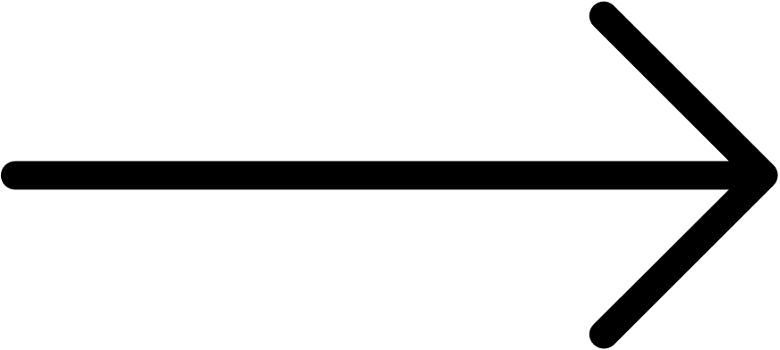
Implementation
Algorithms
Results
Conclusion
References
Abstract
Introduction
Literature review
Existing Method
Drawbacks
Proposed method
Architecture
Advantages.
INDEX

Slide 3
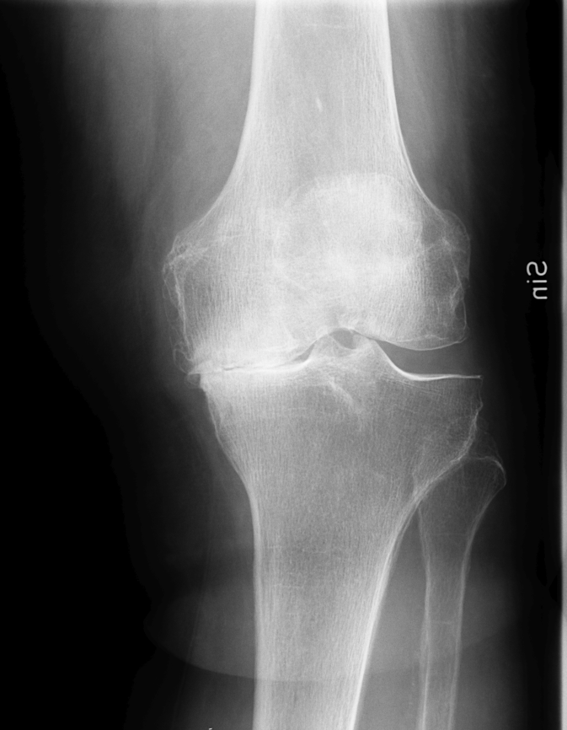
ABSTRACT
Osteoarthritis (OA) disease most caused in elderly people and causes muscle and skeleton system damage.
Due to the availability of different technical algorithms, the image-based prediction to detect the presence of osteoarthritis is carried out from a dataset available on Kaggle.
This work was carried out with different deep learning models like Efficient-V2L, MobileNet, VGG16, and GoogleNet.
The findings justify that the Efficient-V2L model has obtained a good accuracy with 93.96% and performs well to predict OA when compared with other existing models.

Slide 4
INTRODUCTION
Osteoarthritis, also referred to as joint failure, is a widespread, age-related, chronic, and slowly progressing joint condition. The joints most commonly affected by this disorder are overused throughout a person's life, such as the knees, neck, lower back, and small joints at the ends of fingers. The cartilage, a cushion made of a smooth rubber-like material that covers the ends of the bones in the joint, is impacted by this disorder.
As people age, their cartilage, which is the cushion that covers the ends of the bones in the joint, is constantly being replaced, but it has a very limited ability to repair itself. When the cartilage breaks down, it can damage other joint components and the bones themselves. This condition is known as osteoarthritis (OA) and is thought to be caused by a variety of biomechanical and biochemical factors.

Slide 5
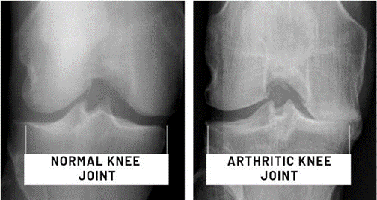
INTRODUCTION
Osteoarthritis is the most common type of arthritis. About 4-6% of adults in India have osteoarthritis, making it one of the top five chronic disorders in the country. According to statistics, India reports more than 10 million cases of osteoarthritis each year.
It is projected that by 2025, India will have the highest number of cases of osteoarthritis in the world, with more than 60 million cases.

Slide 6
LITERATURE REVIEW
S.No | Author | Model | Approach | Accuracy
1 | A.Chetouani, E. Lespessaille s, Y. Nasser, R. Jennane, M. and E. Hassouni | Discriminative regularised auto-encoder (DRAE) | A system that is based on auto-encoders | 0.8173
2 | Ming Zhang , Yaodong Du, Rania Almajalid, Juan Shan | The four methods are Artificial neural network, Naive Bayes support vector machine, random forest | Principal component analysis (PCA) on the feature space determines the most optimal feature set | 0.785
3 | MD.REzaul karim, Jiao Jiao, Till DÖhmen, Stefan Decker, Michael Cochez, Oya Beyan, Dietrich Rebholz- Schuhmann | Gradient-guided class activation maps and layer-wise relevance propagation to highlight regions that distinguish between different classes | The region of interest (ROIs) are extracted using U- Net architecture with ResNet as the backbone. | 0.9145

Slide 7
PROPOSED METHOD
In our proposed method we are performing the classification of whether the person is infected with osteoarthritis or not using the Convolution Neural Network (CNN) of deep learning along with the transfer learning methods of CNN, which are GoogleNet, VGG16, EfficientNetV2L, and MobileNet. When the breakdown of cartilage exceeds the body's ability to repair it, the ligaments around the joint loosen, the joint capsule thickens, the joint fluid becomes thinner, and the muscles weaken. Early diagnosis of osteoarthritis is crucial to ensure curative treatment and increase survival rates. Hence, proper classification is important for the proper treatment which will be possible by using our proposed method.

Slide 8
Pro's and Con's
ADVANTAGES
DISADVANTAGES
• Accurate classification
• Less complexity
• High performance
•Easy Implementation
• Less feature compatibility
• Low accuracy

Slide 9
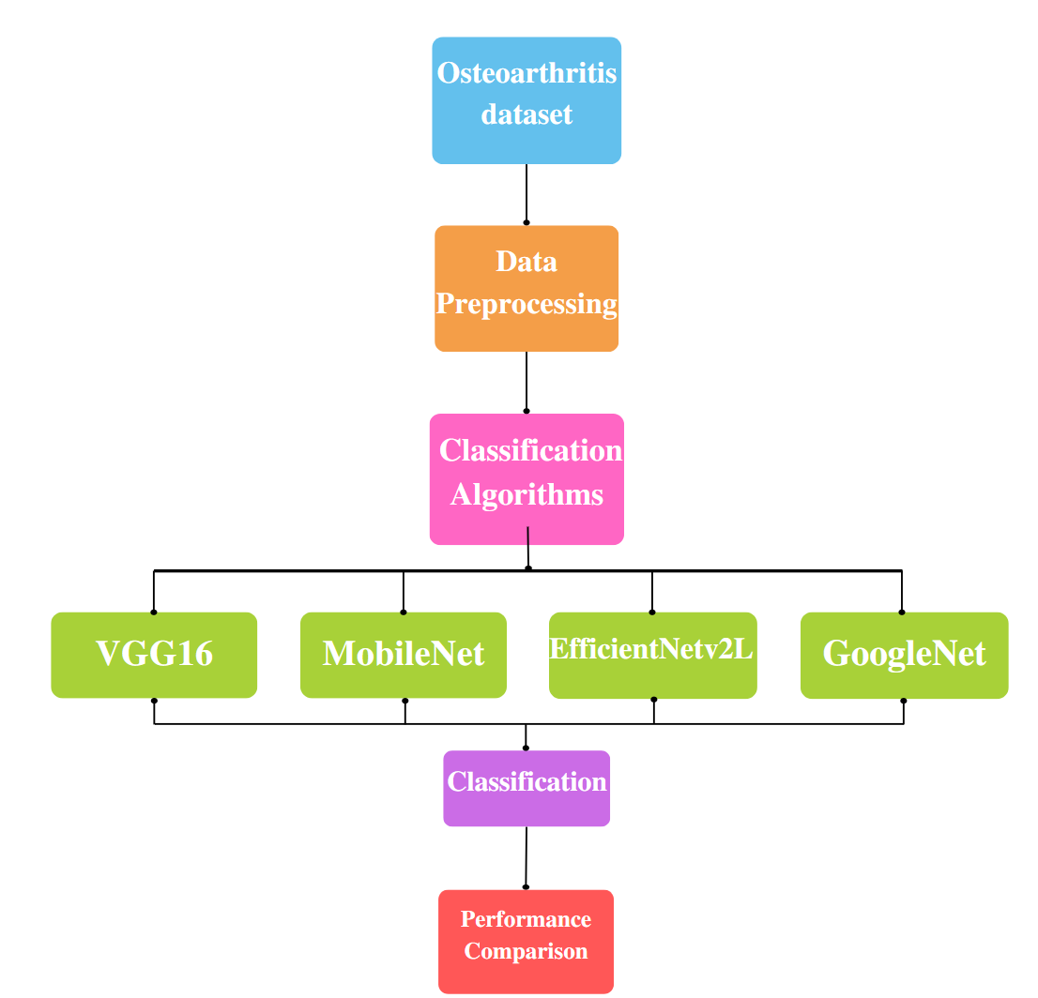
SYSTEM
DESIGN

Slide 10
DATASET
The dataset described includes X-ray images of knees, which are categorized into three stages: Stage I (Healthy), Stage II (Mild), and Stage III (Severe). Stage I represents a healthy knee with no visible abnormalities, while Stages II and III indicate increasing levels of knee degeneration, characterized by the presence of osteophytes (bony growths), narrowing of the joint space, and sclerosis (thickening of bone tissue). The severity of these conditions increases as the stage number increases. The publicly available osteoarthritis dataset utilized in this work was obtained from Kaggle.

Slide 11
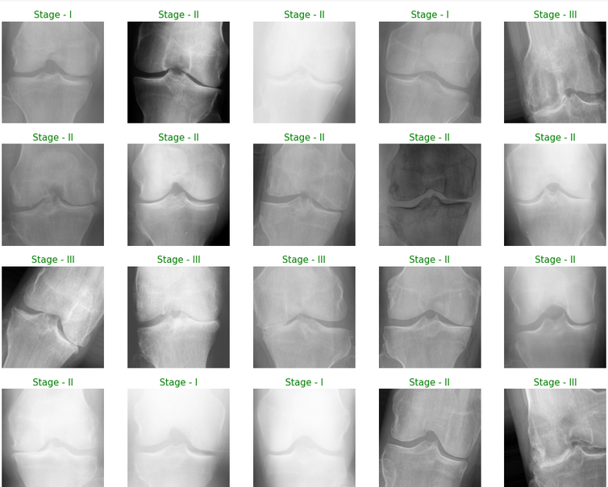
DATASET

Slide 12
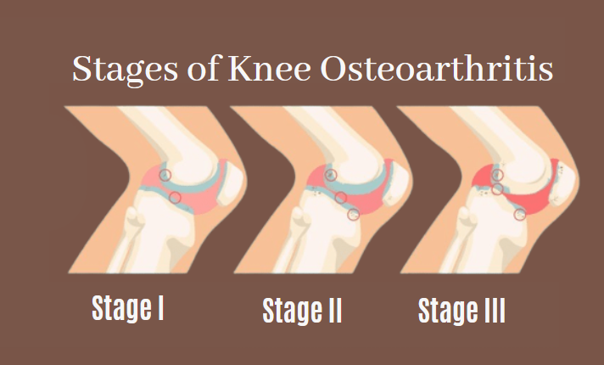


STAGES

Slide 13
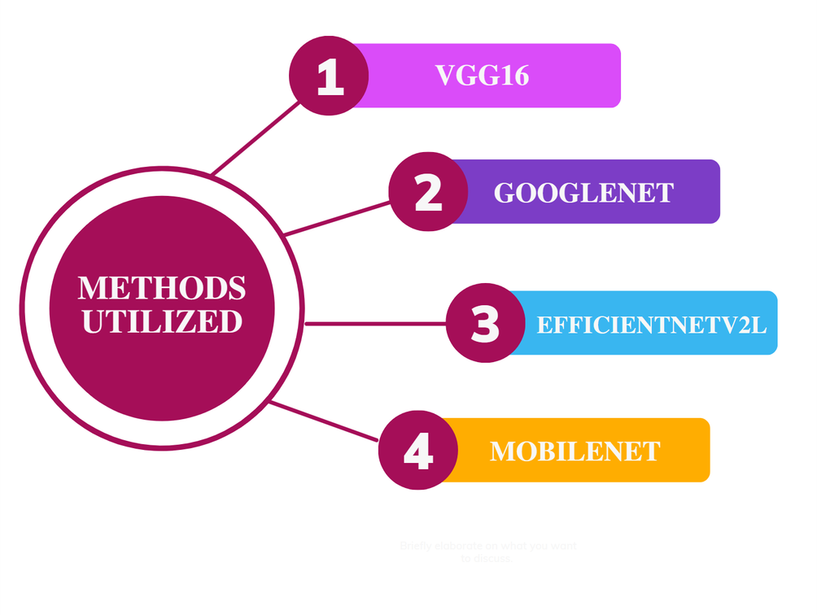
IMPLEMENTATION
This study utilizes several pre-defined CNN architectures, including VGG16, MobileNet, EfficientNetV2L, and GoogleNet. The precision and effectiveness of the dataset is evaluated across all of these architectures. The accuracy of these techniques varies depending on the training and testing datasets used.

Slide 14
GoogleNet
Understanding the GoogleNet Model and CNN Architecture by way of assorted organizations, Google analysts announced Google Net (as known or named at another time or place Inception V1) in the long student essay "Going Deeper accompanying Convolutions" in 2014. This design engages plans like all-encompassing average combining and 1–1 convolutions concurrently with an activity in the design.
Vanishing Gradient
This can prevent the weights of lower layers from being updated effectively.

Slide 15
2. VGG16
The VGG (Visual Geometry Group) developed a convolutional neural network called VGG-16, which is known for its ability to recognize a wide range of objects in images. It is particularly useful for large-scale image recognition tasks and won first and second place in the 2014 ILSVRC challenge. The pre-trained network can categorize objects into 1000 different classes, including everyday objects like a keyboard, mouse, pencil and various animals. It has robust feature representations for a variety of images.

Slide 16
3. MobileNet
MobileNet is a model that uses convolution in a similar way to CNNs and allows for efficient image prediction and makes it suitable for use on mobile devices. In our image recognition model, we utilized convolutional methods as they greatly reduce comparison and recognition times while still providing superior results quickly.

Slide 17
4. EfficientNetV2L
A family of image classification models called EfficientNetV2 outperforms earlier works in terms of parameter efficiency and training speed. Our EfficientNetV2M models are scaled up for quicker training and inference speed and are based on EfficientNetV1 and use neural architecture search (NAS) to simultaneously maximize model size and training speed. Mobile inverted bottle net convolution is employed (MBConv).

Slide 18
TECHNIQUES UTILIZED
Data Augmentation
The goal of this technique is to reduce overfitting by increasing the dataset size, which forces the model to generalize better. In this study, the model applies rotation, horizontal flip, height shift, width shift and shear to the dataset with added noise, but still maintains accurate predictions.
Normalizing
It aims to recenter and rescale the data so that it falls within a specific range, such as between 0 and 1 or -1 and 1.
· It improves training by reducing internal covariate shift
· Reducing network overfitting by promoting regularisation.

Slide 19
TECHNIQUES UTILIZED
On the other hand, The batch normalization technique is used to normalize the contributions of each mini-batch during the training of deep neural networks. This helps to stabilize the learning process and reduce the number of training epochs needed.
L2 Regularization
The large size of the dataset increases the risk of overfitting, which can make the model perform poorly. To address this, we used L2 regularization to prevent overfitting. L2 regularization involves adding a term to the model's equation that is equal to the sum of the squares of the parameters multiplied by a regularization constant.

Slide 20
TECHNIQUES UTILIZED
Categorical Cross-Entropy
When this loss function is used for multi-label classification, the gradients become more complex because the loss has a component for each positive class. In this case, since there are three classes, such as stages 1, 2, and 3 and the classification is multi-class, we used categorical cross-entropy.
Residual Network
The network utilizes a residual mapping method, where it aims to understand the underlying mapping by fitting the residual difference between the original mapping and the input.

Slide 21
Activation Functions
a) ReLU
The ReLU (Rectified Linear Unit) outputs a value of zero for negative inputs and the input value itself for positive inputs. This function is widely used, making it a standard for many types of neural networks
b) Softmax
In the final layer of the network, we used the softmax activation function. It produces better results when there are multiple classes present. The softmax function helps to convert the probability scores into a normalized probability distribution, making it a preferred choice over other functions for this purpose.

Slide 22
Hyper Parameters
MODEL CHECKPOINT | The model checkpoint callback allows for flexibility in how the model is saved.
DROPOUTS | The model checkpoint callback allows for flexibility in how the model is saved.
ADAM OPTIMIZER | This technique helps to decrease the training time by efficiently adjusting the learning rate.
LEARNING RATE | A standard learning rate of 0.001 is used at the start of the training process, but we also adjusted it based on the validation loss that occurred after some epochs.

Slide 23
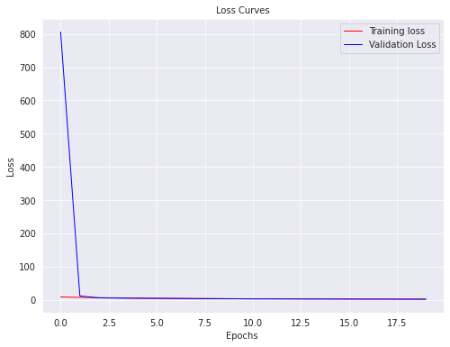
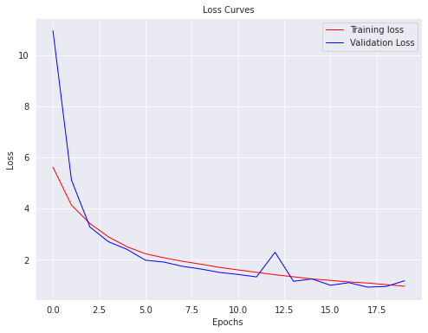
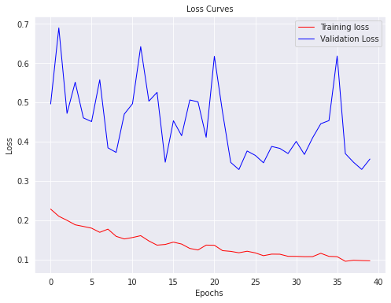
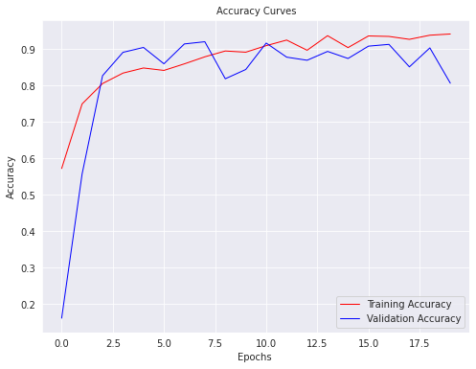
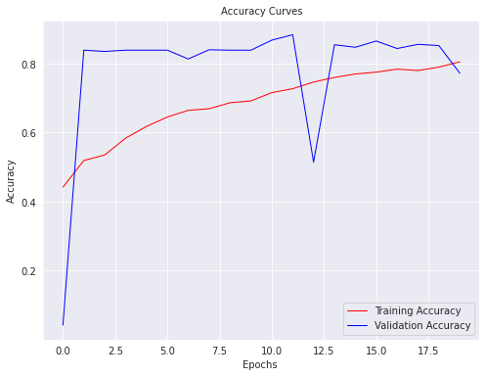
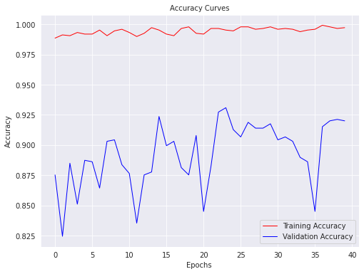
RESULTS
Google Net
VGG16 MobileNet EfficientNetV2L

Slide 24
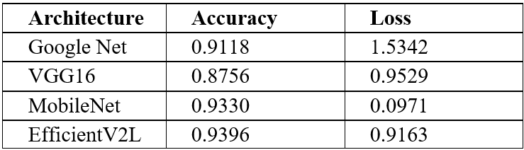
Accuracies

Slide 25
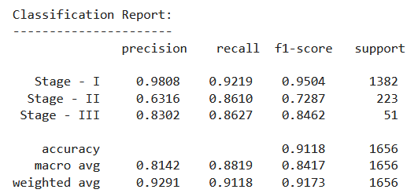
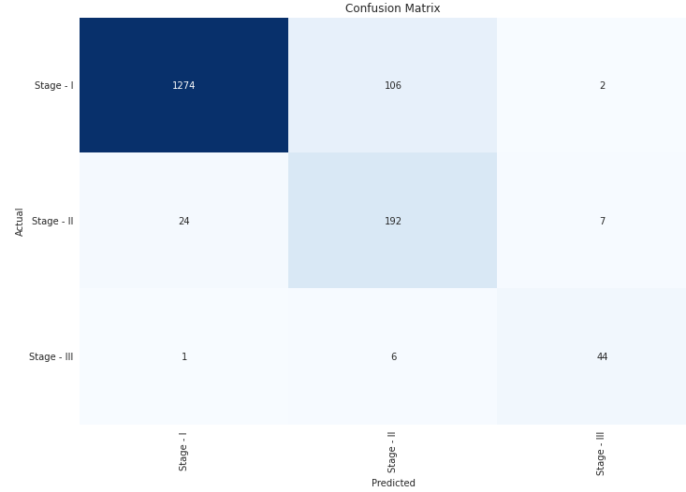
GoogleNet

Slide 26
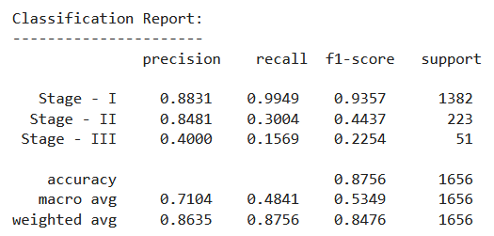
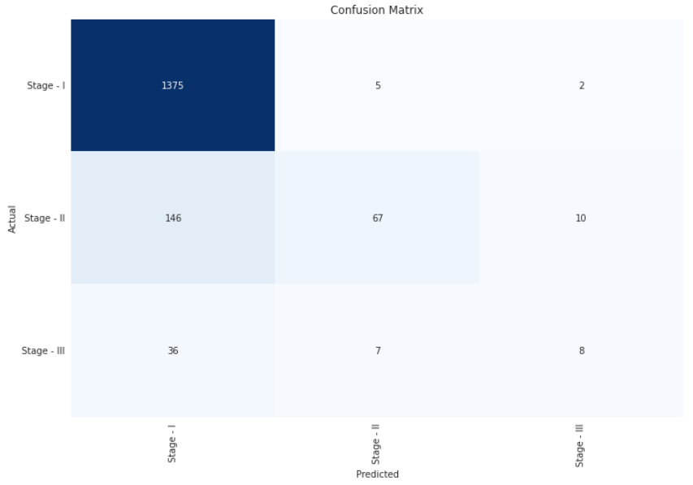
2. VGG16

Slide 27
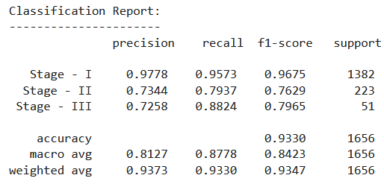
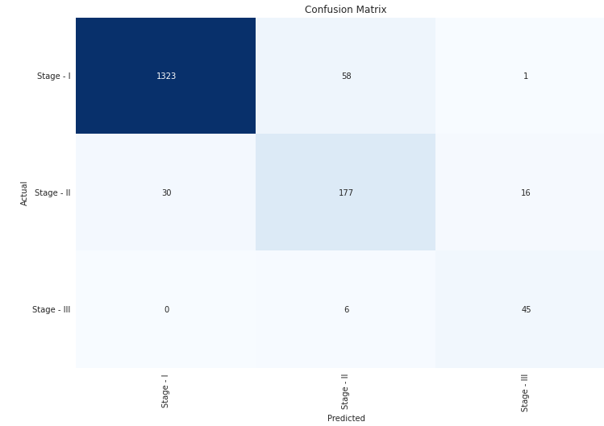
3. MobileNet

Slide 28
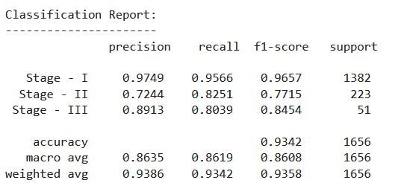
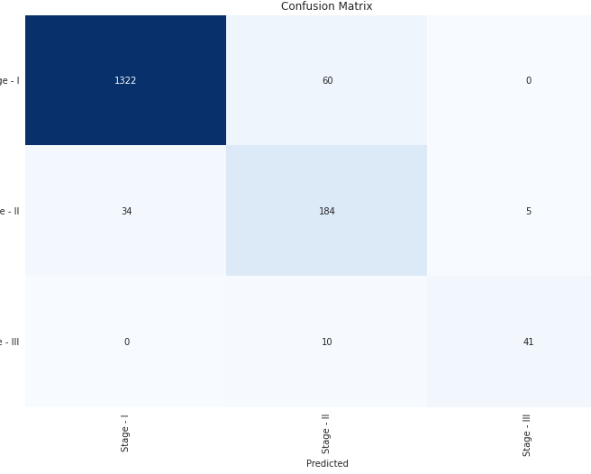
4. EfficientNetV2L

Slide 29
Conclusion
In this study, a unique model for learning representation from X-ray images of the knee was proposed for identifying osteoarthritis. Four models were developed and compared for determining if a person has osteoarthritis. According to the results, the EfficientNetV2L model had the highest classification accuracy. This research can aid medical professionals in quickly screening and diagnosing osteoarthritis by utilizing a large amount of data. The results of this study align with previous research that found the medial compartment of the knee to have the most informative regions for diagnosis. Additionally, this study shows that the accuracy can be further improved by utilizing CNN architectures.

Slide 30
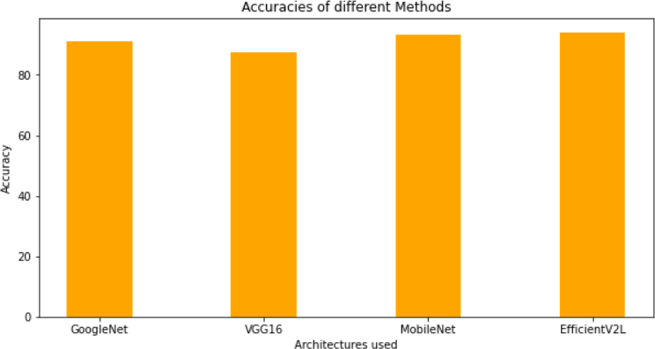
Comparision

Slide 31
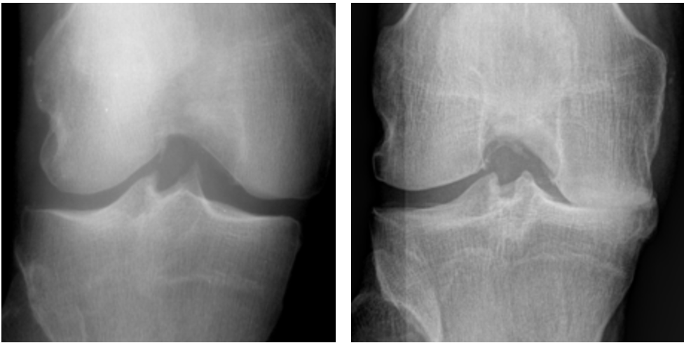



Thank
You!

